Slide 1
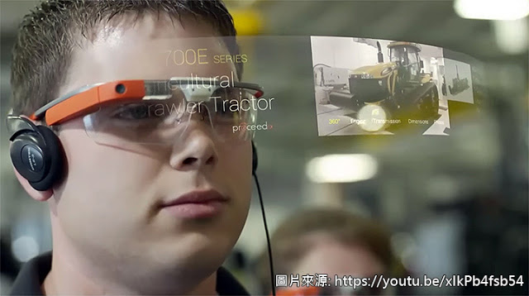
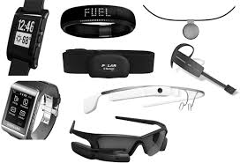
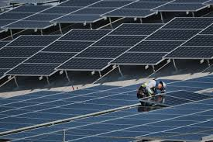
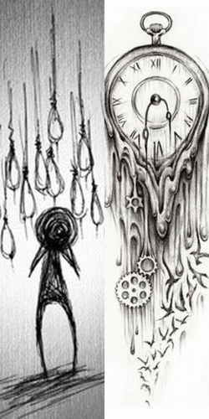
Technology
Trending
Educational is who you are working with
Create a word bank for discussion
Open a shared document
and share common notes
Distance learning
Reduced attention spans of students
collaborative learning
Every coin has two sides
Rewards for reducing ones carbon footprint
Carbon footprint
How to teach critical thinking
How can teachers take more risks?
In groups that are highly attuned and sensitive to each other ideas can flow.
How to prepare for jobs that don’t yet exist?
Change our thinking and change the solution
Christopher Bauman – www.chrisbauman.com.au

Slide 2
Asynchronous learning
1. Disruptive technology? Environmental disruption?
____________________________________________________________________________________________?
Advanced Question Words
2. Blockchain makes trust obsolete ___________________________________________________________________________________________ ?
Touch on
Carbon footprint
3. Technology – help or hindrance / distraction? ___________________________________________________________________________________________ ?
Differentiation
4 How do you enjoy the real world? ___________________________________________________________________________________________ ?
Quite frankly
blockchain
5. Should using technology be fun? ___________________________________________________________________________________________ ?
Internet – a space for asking questions
6. How can classrooms collaborate with each other? ___________________________________________________________________________________________ ?
Peer to peer network
Collaborative technology
7. Try asking questions to ascertain a piece of technology hat your friend ahs thought of. ___________________________________________________________________________________________ ?
Easily distracted generation
10 second customer grab
8.Organisaational skills __________________________________________________________________________________ ?
Pushing the envelope.
Christopher Bauman – www.chrisbauman.com.au

Slide 3
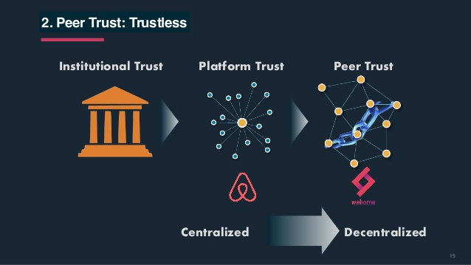
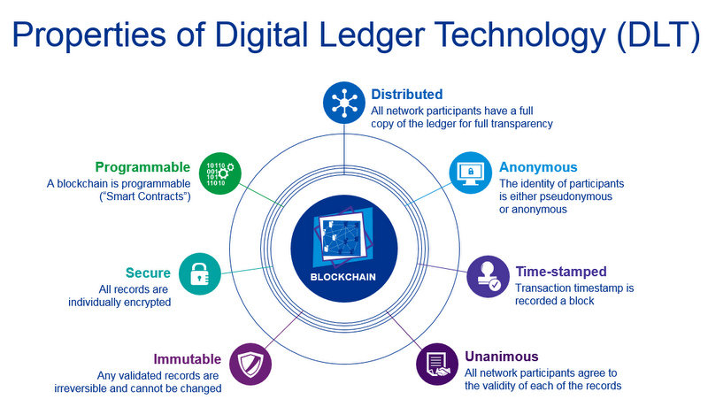
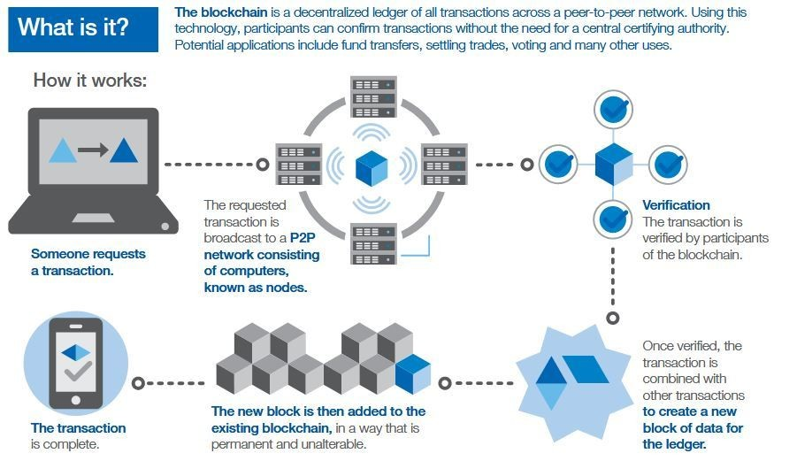
Blockchain

